Slide 1


Pets To Go Proposal and Organization
Key facts about Proposal
Objective is to create and provide awareness and interest in Pets To Go Start up company through visual, informational and form interaction.
Visual impact – Eye appealing and colorful images to carry out the mission of the
of the company and its interests.
Informational content- The goal is to educate the viewer and potential clients/vendors of the mission of the Co. Through informational content provided by Pets To Go.
Form interaction- Create a form to provide user information and interest to the client (Pets To Go)
See more: Open the Notes below for more information.
Notes:
QuickStarter has created an outline to help you get started on your presentation. Some slides include information here in the notes to provide additional topics for you to research.

Slide 2
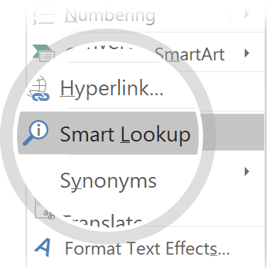
Related topics to research
Request for proposal
Research popular website for dynamic ideas
List objectives for each page – identify importance and precedence and photo layout.
Prepare content and layout – index, 4 additional pages
Final draft – check for any red marks and buggs in programming
Create Market speech for introduction.
Use Smart Lookup to learn more
1
Highlight one of the related topics
Right-click on the topic
Choose "Smart Lookup"
2
3

Slide 3

Proposal
Pets To GO

Slide 4
Contents
Index
Services
About Information
Donation
This Photo by Unknown Author is licensed under CC BY-SA

Slide 5
INDEX PAGE
Meta tag
Intro to company , Mission Statement
Services link to service page
Get email for newsletter
Header / column structure
Footer: email link
Sidebar- links to external pages
Sidebar
Title
Content
Logo
Footer
Notes:
Consider talking about:
Informally solicited proposal
Unsolicited proposal

Slide 6
SERVICES PAGE
Ul for services (possible check marks for interest
Add descendant selector
Class selector
Header / column structure
CSS comments
Header
List of services
Photo
Photo
Photo
Footer
Notes:
Consider talking about:
Formally solicited proposal
Informally solicited business proposal

Slide 7
ABOUT PAGE
Header / column structure
Location, phone , contact info
Link to home page
Pseudoclass selector (email hover)
Pseudoelements
Print style
Founder Picture
Title
Founding Photo
Content
Footer
Notes:
Consider talking about:
The process of proposal management

Slide 8
DONATION/VOLUNTEER PAGE
Header / column structure
Hyperlinks
Email link
Photo
Form – sign up, email user info
Header
Form
Footer
Notes:
Consider talking about:
Internal Proposals
Sole-source Contract
Format
Title
Abstract
Statement and Method
Budget
Biographical information
Sponsor Values
Applicant Credibility

Slide 9
EXTERNAL LINK
Background image
Poss. Javascript elements
Hyperlinks to ASPCA etc
MAP to Location
Title
Links to outside websites, external information
Footer

